Slide 1
Evaluating Gender Bias in Textual Data Using NBias: A Natural Language Processing Perspective
Group: 17
Protiva Das 24166051
Tamima Binte Wahab 24166052
CSE713

Slide 2
Abstract
This study explores gender bias in textual comments, utilizing a secondary dataset from Kaggle to address the growing issue of gender-related discrimination globally. We processed and analyzed the data using advanced NLP models like LSTM, Bi-LSTM, GRU, Bi-GRU, BERT, and DistilBERT. Our findings indicate that BERT and DistilBERT are particularly effective in detecting early signs of gender bias. This research contributes to reducing the negative impact of biased comments and extends the methodology for future studies on various forms of bias, such as religious and political bias, promoting a more inclusive social environment.

Slide 3
Introduction
We aim to detect gender biases in textual comments, addressing the broader societal issues of gender equality and psychological impact.
Utilizing a secondary dataset from Kaggle, we gathered a range of textual comments for analysis.
Our methodology involved advanced NLP models such as LSTM, Bi-LSTM, GRU, Bi-GRU, BERT, and DistilBERT to process and analyze the data.
The primary goal is to identify biases early to mitigate their negative effects and promote inclusivity in both online and offline spaces.
This research contributes to the existing literature by focusing on gender biases specifically, paving the way for future work on creating safer communication environments.

Slide 4
Related Works
The model of the research struggles with misspellings, severity changes, and embedded biases across texts and shows inconsistent performance across languages and domains due to linguistic and cultural differences. [1]
This study was limited to binary classification and English language. [2]
The evaluation mainly used English datasets and focused on textual biases, neglecting image and audio biases, and did not explore newer technologies like LLAMA 2 and GPT-4. [3]

Slide 5
Dataset
The dataset hosted on Kaggle, titled "Explainable Detection of Online Sexism (EDOS)," is designed to facilitate the study of sexism in online environments by providing annotated comments for machine learning applications. This dataset supports research aimed at developing algorithms capable of identifying and analyzing sexist language, contributing to broader efforts to mitigate online harassment and promote gender equality. https://www.kaggle.com/datasets/maifeeulasad/explainable-detection-of-online-sexism-edos

Slide 6
Models
LSTM: LSTM is ideal for this research because its ability to remember long-term dependencies helps in accurately detecting subtle gender biases in lengthy texts.
Bi-LSTM: Bi-LSTM enhances the detection capabilities by analyzing text from both forward and backward directions, capturing more contextual nuances related to gender bias.
BERT: BERT is advantageous due to its deep understanding of context within language, making it highly effective in identifying intricate patterns of gender bias in text.
DistilBERT: DistilBERT provides a lightweight but powerful alternative to BERT, maintaining essential features for bias detection while requiring less computational resources.
GRU: Streamlines sequence learning with a simpler, efficient architecture that captures temporal dependencies effectively.
BiGRU: Enhances sequence analysis by reading data forwards and backwards, boosting context comprehension and accuracy.

Slide 7
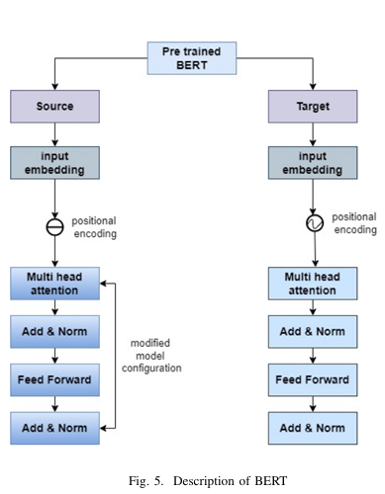

Slide 8
Methodology
Categories of the Comment:
1) ID Rewire, 2) Comment, 3) Sexiest label, 4) Category label, & 5) Vector label.
Reason for Selecting this Dataset:
1) Animosity
2) Online threats
3) Prejudiced Discussion
4) Derogation

Slide 9
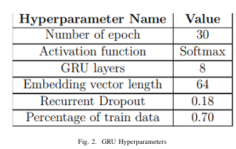
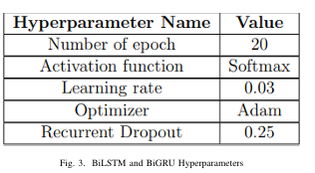
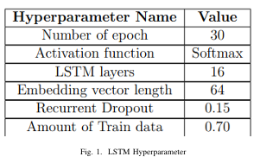
Fig: LSTM, GRU, BiGRU, BiLSTM Hyperparameters.

Slide 10
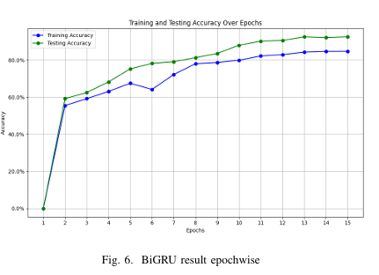
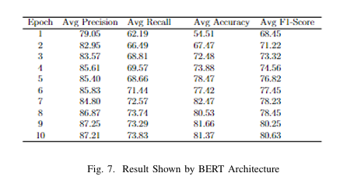

Slide 11
Result Analysis
Performance Evaluation: The study primarily utilizes precision, recall, and accuracy metrics to assess model performances, with Table 7 highlighting that the BiGRU model excels over others.
Class-Specific Results: These metrics are calculated for each class within the dataset, which ranges from ratings of 1 to 5 with associated comments, summarized in Table II-E.
F1-Score Comparison: A specific focus is placed on the F1-score, where BiGRU outperforms competing models, achieving the highest score of 92.45%.
Comparison with Other Models: The lowest F1-score observed is from the ANN model at 81.25%, positioning BiGRU as the superior choice among the evaluated RNN architectures,

Slide 12
Overview
This research aims to detect gender bias in textual data using NLP models like LSTM, Bi-LSTM, GRU , BiGRU and BERT, and DistilBERT, analyzing comments from a Kaggle dataset. Our goal is to identify effective tools for early bias detection to enhance inclusivity in digital spaces. This study not only tackles key societal issues but also paves the way for future investigations into various biases, improving the handling of diversity in communication.

Slide 13
Referencing
Raza, S., Garg, M., Reji, D. J., Bashir, S. R., & Ding, C. (2024). Nbias: A natural language processing framework for BIAS identification in text. Expert Systems with Applications, 237, 121542.
Bashar, M. A., Nayak, R., Kothare, A., Sharma, V., & Kandadai, K. (2021). Deep learning for bias detection: From inception to deployment. In Data Mining: 19th Australasian Conference on Data Mining, AusDM 2021, Brisbane, QLD, Australia, December 14-15, 2021, Proceedings 19 (pp. 86-101). Springer Singapore.
, S., Bamgbose, O., Chatrath, V., Ghuge, S., Sidyakin, Y., & Muaad, A. Y. (2023). Unlocking Bias Detection: Leveraging Transformer-Based Models for Content Analysis. arXiv preprint arXiv:2310.00347.

Slide 14
Thank You
Any Questions/Suggestions?

